Slide 1
Economics of digital markets
Patrick waelbroeck

Slide 2
Economics of digital markets
Patrick Waelbroeck

Slide 3
Lecture 3
Price discrimination

Slide 4
Price discrimination: introduction
Title: Presentation
Subtitle field
Charge different consumers different prices for same product
Examples:
Movies (adults, children, seniors)
Movies: theatrical release, pay per view, dvd, cable, television
Books: Hardcover and paperback
Software: full versus ‘lite’ versions

Slide 5
Price variation vs. Price discrimination
Title: Presentation
Subtitle field
Not all price differences are the result of price discrimination. Costs of dealing with different customers are not always the same.
Electricity generation has generally been less costly in the Northwest. Some customers are more prone to return purchases than others.

Slide 6
Example: Peak load pricing
Title: Presentation
Subtitle field
At capacity, marginal costs include
Costs of expanding capacity
Value of unserved customers
For electricity, airlines, hotels, marginal costs fluctuate dramatically
Pricing should reflect likelihood of sellout or reaching capacity
Mobile telephone calls

Slide 7
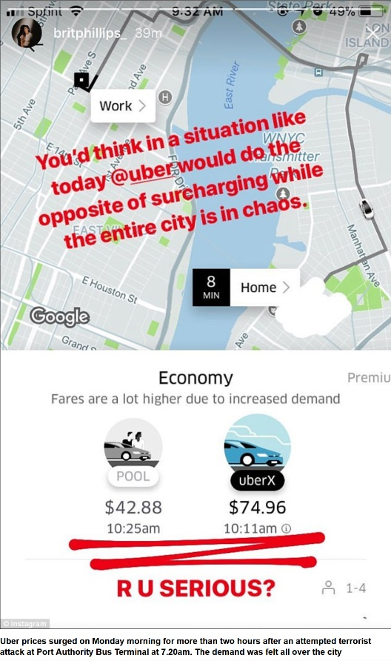
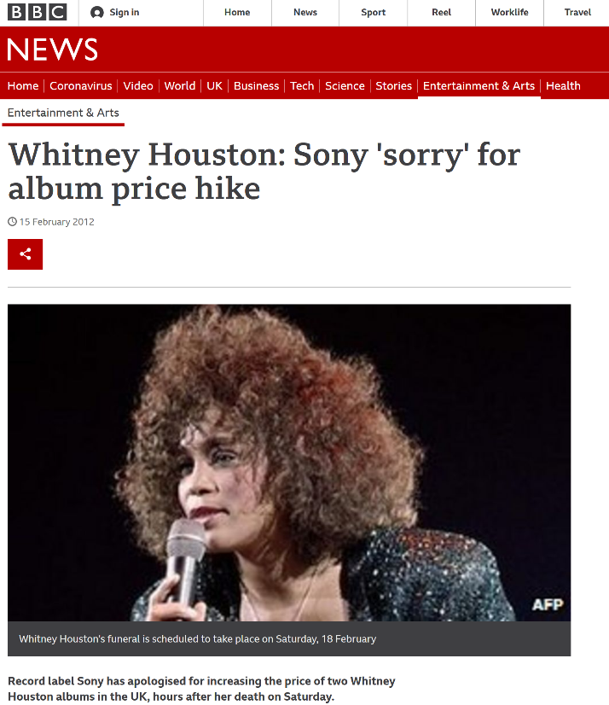
What about surge prices? Whitney houston?
Title: Presentation
Subtitle field

Slide 8
Price discrimination: definition
Title: Presentation
Subtitle field
Two varieties of a good are sold (by the same seller) to two buyers at different net prices
Net price = price after including cost related to product differentiation (delivery cost for instance)

Slide 9
Price discrimination - typology
Title: Presentation
Subtitle field
First degree (perfect): seller charges a different price for each good exactly equal to willingness to pay of buyer
Second degree (nonlinear, quantity discount): prices differ by amount of good purchased, not by consumer.
Third degree: different consumers charged different prices

Slide 10
Price discrimination law
Title: Presentation
Subtitle field
Illegal if it gives some firm an advantage over other firms.
If individuals are consumers, is not illegal.
Price Discrimination is not likely to harm efficiency. Perfect Price discrimination is perfectly efficient.
Intention of this rule was to protect ‘mom-and-pop’ stores and grocers from department stores and supermarkets. It was intended to reduce competition.

Slide 11
Conditions for price discrimination
Title: Presentation
Subtitle field
Market Power: If firm is price taker, cannot charge markup
But: can have price discrimination in markets with free entry and competition
Firm must have some knowledge of consumer’s willingness to pay.
Third degree: must know how the elasticity of demand differs across markets.
Second degree: must have some knowledge about the different “types” of consumers that exist in the market place.
Prevent or limit resale

Slide 12
How to prevent resale?
Title: Presentation
Subtitle field
Legal restrictions (computer software, educ. discount)
Services cannot be resold.
Warranties: the firm can void a warranty if the product is resold.
Adulteration: Make the product unfit for other potential uses (damaged goods)
Ex: food

Slide 13
How to prevent resale? (cont.)
Title: Presentation
Subtitle field
Transactions costs/switching costs/lock-in: If markets are spatially separated or barriers imposed by tarrifs, taxes, resale is more expensive (ex: email address, mobile phone #)
DVD/BR region lock
IP/geo-blocking
Vs. copyright law?
Contractual remedies
iTunes/Ebay case
Vs. Copyright law: Oracle/Usedsoft
Exhaustion/first sale doctrine
Injunction against against UsedSoft in 2007
Case withdrawn in 2015

Slide 14
Perfect Price discrimination
Title: Presentation
Subtitle field
Find maximum price that every consumer is willing to pay and charge them that price.
Requires more information than any firm has
No Deadweight Loss but no consumers surplus
Theoretical ideal. Cannot be fully achieved.
But: big data, machine learning, IA, etc.
Extracts all surplus on the market
= VALUE OF DATA
Discussion: fairness vs. Pareto optimality

Slide 15
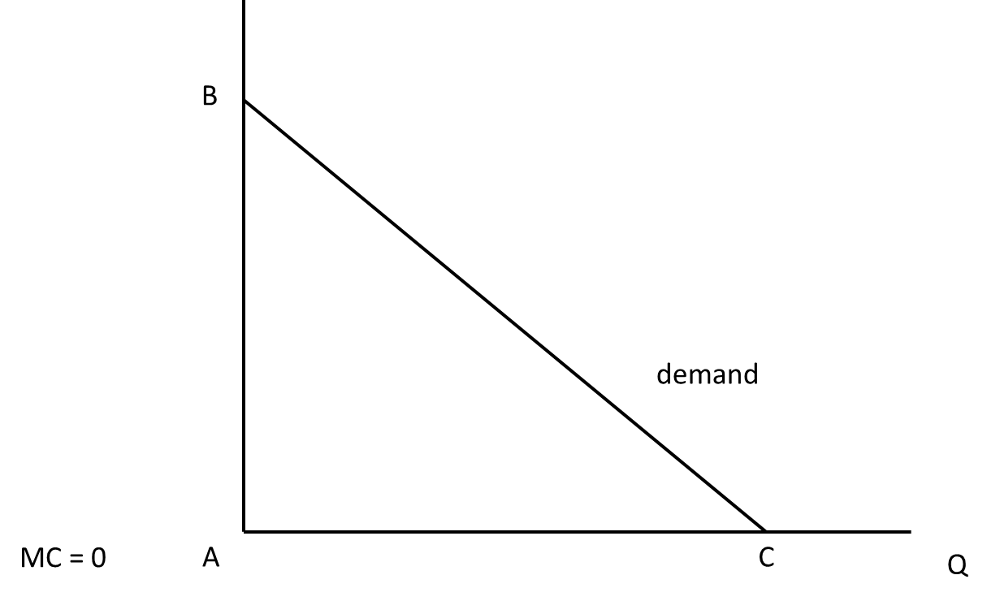
Perfect price discrimination
Title: Presentation
Subtitle field
Consumer surplus?
Producer surplus?

Slide 16
Fairness
Title: Presentation
Subtitle field
Fairness vs. Optimality
Competition authorities only interested in consumer surplus

Slide 17
Third degree price discrimination
Title: Presentation
Subtitle field
Different customers are charged different prices based on observed demographic characteristics (related to elasticity).
Geographic markets
Product use markets
Customer types (senior citizen, students)

Slide 18
Price discrimination with two or more markets (cont.)
Title: Presentation
Subtitle field
If markets for a single product have different MRs, profits can be increased by shifting output from low MR markets to high MR markets.
Elasticity (en %) = (∆Q/Q)/(∆P/P)
Need to Prevent Arbitrage.
Examples: Airlines with business travelers and vacationers. Coupons.

Slide 19
Elastic demand
Title: Presentation
Subtitle field
1%

Slide 20
INElastic demand
Title: Presentation
Subtitle field
1%

Slide 21
Price discrimination with two or more markets
Title: Presentation
Subtitle field
If markets for a single product have different MRs, profits can be increased by shifting output from low MR markets to high MR markets.
Raise price in low MR market and lower price in high MR market.
High MR market is high elasticity market.
Elasticity (in %) = (∆Q/Q)/(∆P/P)
Need to Prevent Arbitrage.
Examples: Airlines with business travelers and vacationers. Coupons.
.

Slide 22
Second degree price discrimination
Title: Presentation
Subtitle field
Heterogeneous consumers.
Ex: some consumers want 2 units and some consumer only want one unit.
No observed characteristics that can be used to forecast willingness to pay for a given unit
The consumer’s demand is private information
Heterogeneous tastes for different quantities
Value first unit more than later units
Each consumer has downward-sloping demand

Slide 23
Examples of second degree price discr.
Title: Presentation
Subtitle field
Monopolist offers “menu of bundles” to choose from
Examples:
Two part tariff: fixed fee plus fee for each additional unit
Long-distance phone service
Disneyland: admission fee and fee per ride
Alternative bundles
Mobile phone service (100, 500, 1000 minutes)

Slide 24
Two-part tariff
Title: Presentation
Subtitle field
The two-part tariff is another common example of non-linear pricing.
A two-part tariff consists of fixed fee and a per unit charge.
The fixed fee is the amount the consumer must pay for the right to purchase any amount of the good.
The per unit charge is the price the consumer pays for each unit of the good.

Slide 25
Two-part tariff strategy
Title: Presentation
Subtitle field
If a monopolist is able to use a two-part tariff, she will set the per unit charge equal to the competitive equilibrium price and the fixed fee equal to the competitive consumer surplus.
Remember that the competitive equilibrium was the solution that allowed the most total surplus.
By setting the per unit charge equal to the competitive price, the monopolist preserves the largest possible surplus and then capitalizes on it by setting the fixed fee equal to the surplus.

Slide 26
bundling
Title: Presentation
Subtitle field
Two or more products that are sold as a package in fixed ratio.
CDs versus singles
Cable television bundles versus a la carte.
Subscription services versus pay per use –cable blanket versus long distance telephone or pay per view; Rhapsody versus iTunes.
Computers with software
Office suites versus individual components.

Slide 27
Bundling and tie-in
Title: Presentation
Subtitle field
Bundling: firms sell two or more products combined in fixed ratio
Microsoft Office
Internet Explorer and Windows
Idea: charge more to consumers with a low value for one good but high value for the other
Tie-in sales: consumers that buy one product are required to make all future purchases of another product from the same firm.
Xerox copiers and paper or service
Printers and toner

Slide 28
When to bundle?
Title: Presentation
Subtitle field
Mark: values "Baby one more time" at $3, "I will still love you" at $1
Sally: values "I will still love you" at $3, "Baby one more time" at $1
Individual pricing:
Sell each song at $3 or $1
At a price of $3 sell 1 to each, per person profits = $3
At a price of $1 sell 2 to each, per person profits = $2
Total profits: $3 + $3 = $6
Bundling
Sell bundle at $4 to both: profits = $8s.

Slide 29
When to bundle? (cont.)
Title: Presentation
Subtitle field
Bundle products that are substitutes
When consumers want one or the other
When valuations are negatively correlated
Offer complements separately
Offer both if consumers are mixed

Slide 30
Issues with bundling
Title: Presentation
Subtitle field
CDs versus singles- pricing (cannibalism).
iTunes versus prior models.
Cable television bundles versus a la carte; competition in content
Internet explorer vs. Netscape

Slide 31
versioning
Title: Presentation
Subtitle field
Sometimes (frequently) creating different grades of products might just better meet consumer demands.
Versioning is artificially creating different products (where the high end product would meet all needs) to achieve price discrimination.
+: market expansion
Problem: avoiding cannibalization of higher end product line.

Slide 32
Examples of versioning
Title: Presentation
Subtitle field
Luxury versus regular automobile brands.
PC Junior.
‘lite’ versions of software with reduced functionality.
Putting identical chips in high and low powered calculators.
By delaying introduction
Hardcover then later paperback books
Film release, then video, then television

Slide 33
Examples of versioning: Quicken
Title: Presentation
Subtitle field
Quicken Basic $34.95
Quicken 2001 Deluxe $59.95
Quicken Home & Business $79.95
Payroll & invoicing
Quicken 2001 Suite $99.95
Tax Software
Home & Business Suite $139.95
Payroll & invoicing
Tax software

Slide 34
How many versions?
Title: Presentation
Subtitle field
Usually have at least three for software
Low-priced: focus on price over functionality
E.g., personal, essentials,
Mid-priced: balance of two
High-priced: for those who want all functions
E.g., professional
Majority will avoid extremes
With three choices nearly half generally buy mid-priced version

Slide 35
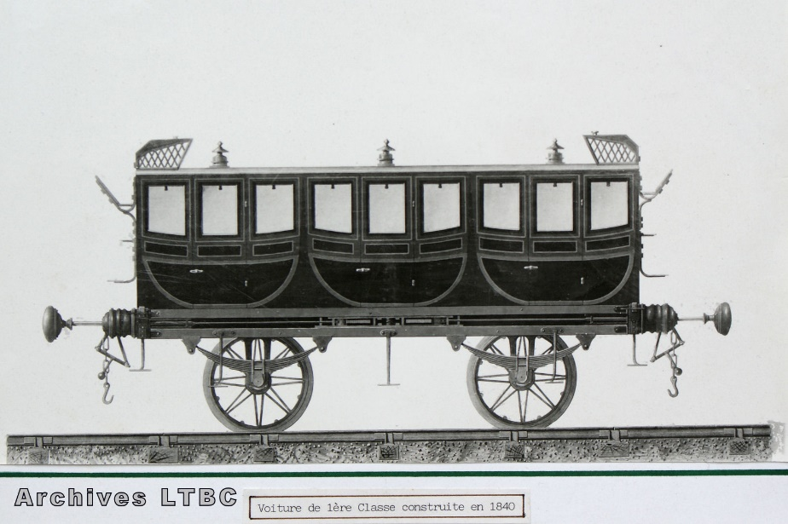
How to prevent arbitrage?
Title: Presentation
Subtitle field
First class PO wagon
3 compartments
1840

Slide 36
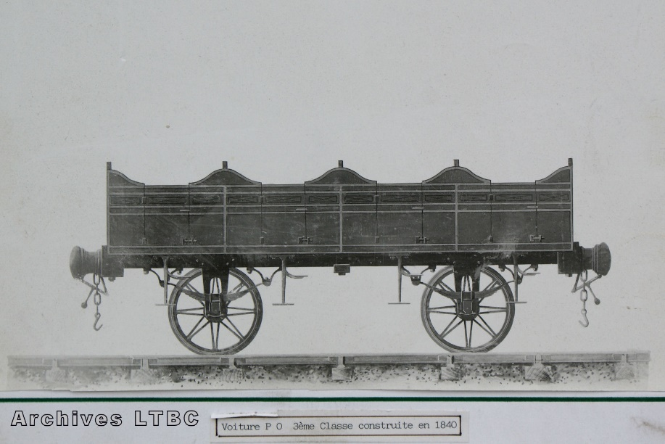
How to prevent arbitrage? (cont.)
Title: Presentation
Subtitle field
Third-class PO Wagon
4 compartments
1840

Slide 37
How many versions?
Title: Presentation
Subtitle field
Introduce a new version if profits increase
Market expansion > cannibalization
Choice of the number of versions can change with market dynamics

Slide 38
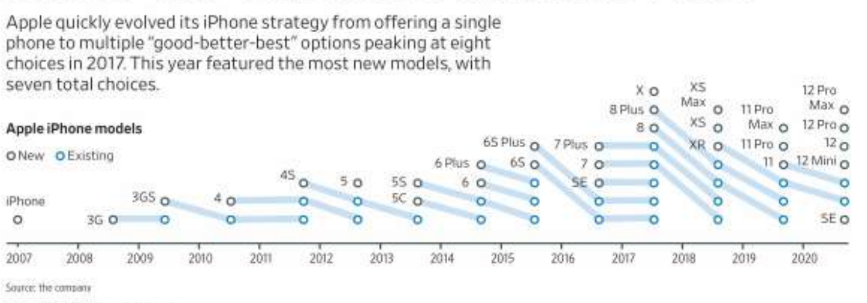
iphone versioning
Title: Presentation
Subtitle field

Slide 39
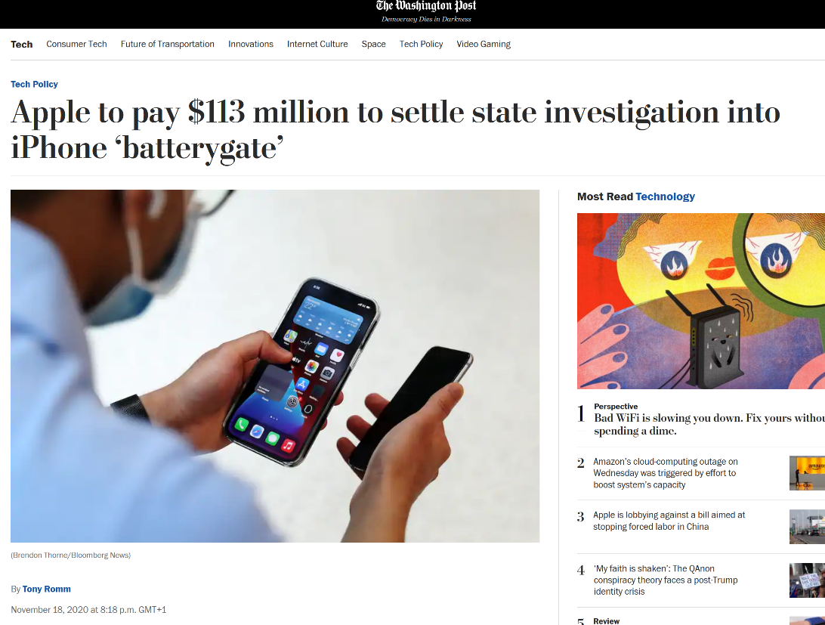
Damaged goods
Title: Presentation
Subtitle field

Slide 40
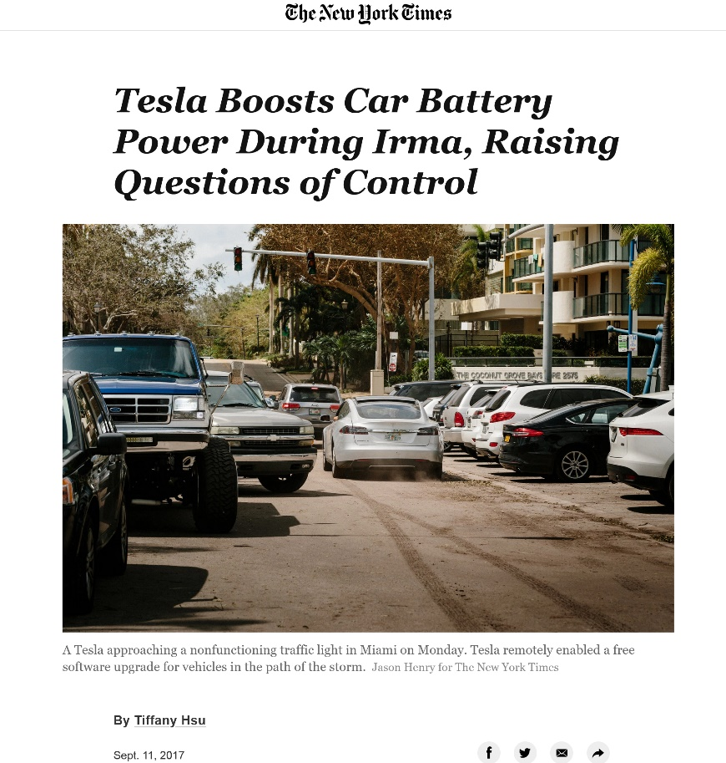
Damaged goods
Title: Presentation
Subtitle field

Slide 41
Other examples of damaged goods
Title: Presentation
Subtitle field
Lite/student versions of software
Intel 386 SX/486 SX
Minidiscs

Slide 42
Free version - Sampling
Title: Presentation
Subtitle field
For physical goods, generally too expensive to give away for free
Marginal cost is not low
For digital goods, marginal cost near zero
Build interest and market by giving away
But need people to pay eventually
Example:
Spotify

Slide 43
Free version – network externalities
Title: Presentation
Subtitle field
Direct externalities
F2P online games
Example: Fortnite
Indirect externalities
Example: linkedin

Slide 44
Intertemporal price discrimination
Title: Presentation
Subtitle field
Charge a high price today and attract high-value consumers; then setting a low price tomorrow to sell to low-value consumers
Example: sales
Problem: buyers anticipate that and if they are patient, firm is forced to set a low price today
Problem: Coase's conjecture
A durable good monopolist "competes with himself“
Example : “Loi du prix unique” (France) for physical book and e-books

Slide 45
Intertemporal price discrimination
Title: Presentation
Subtitle field
Consumers are ranked according to their WTP
Prices decrease over time
Consumer surplus?
Producer surplus?

Slide 46
Avoiding Coase’s trap
Title: Presentation
Subtitle field
Flow of new customers willing to pay relatively high prices.
Rent rather than sell the product.
Improve the product, increase old consumers’ demand. OR: fuel future demand by engaging in planned obsolescence (intergenerational incompatibility). 2 typical patterns:
a user upgrades one component of her system, which degrades the performance of another component;
other users upgrade their software, so that it is no longer compatible with the single user’s software.
Commit not to lower price/Reputation (de Beers)
Make good non-durable
Fads, fashion
Make capacity constraints so expanding output costly
Most favored customer clause or Best price
Buy back guarantee

Slide 47
Application to AI and algorithms
Title: Presentation
Subtitle field
Coase conjecture = limits of predictive algorithms

Slide 48
Welfare effects of price discrimination
Title: Presentation
Subtitle field
Ambiguous
First degree
Consumer surplus + producer surplus under first degree price discrimination is the same as under perfect competition.
First degree price discrimination is efficient.
Unfair

Slide 49
Welfare effects of price discrimination
Title: Presentation
Subtitle field
Second and third degree
Can raise/lower welfare for certain groups.
On an airplane, if all customers were charged the same price, last minute travelers might be made better off while travelers who book far in advance might be made worse off.
Students/low value typically better off if they wouldn’t be served under monopoly
Typically need increase in quantity for increase in welfare

Slide 50
Title
Subtitle

